Slide 1
Animation
The Twelve Principles of Animation
Plus images from http://richard-wood.co.uk/ animation/12-basic-principles-of-animation/
Photos taken by Eadweard Muybridge (died 1904), first published in 1887 at Philadelphia (Animal Locomotion).
This image (or other media file) is in the public domain because its copyright has expired.

Slide 2
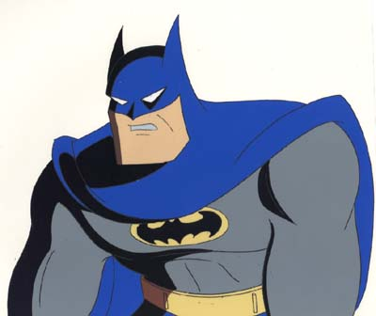
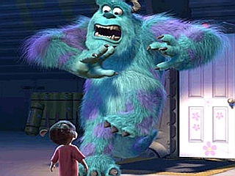
Two main categories
Computer-assisted animation
2D & 2 1/2 D
Inbetweening
Inking, virtual camera, managing data, etc
Computer generated animation
Low level techniques
Precisely specifying motion
High level techniques
Describe general motion behavior

Slide 3
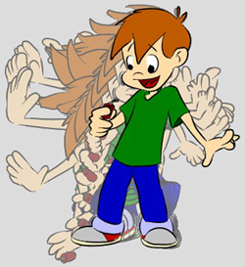
Low level techniques
Shape interpolation (in-betweening)
Have to know what you want

Slide 4
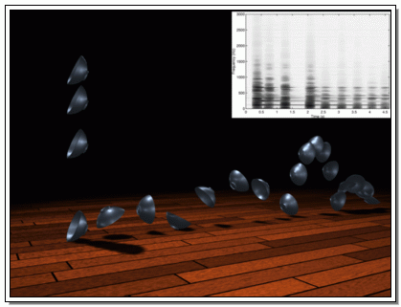
High level techniques
Generate motion with set of rules or constraints
Physically based motion
http://www.cs.berkeley.edu/~job/Projects/SoundGen/video.html

Slide 5
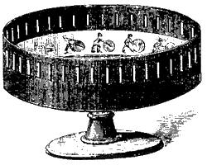
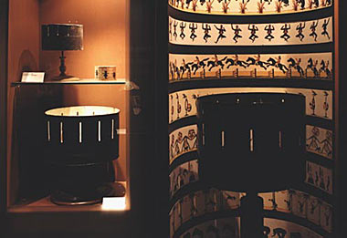
Heritage of Animation
Persistence of vision: discovered about 1800s
Zoetrope or “wheel of life”
Flip-book

Slide 6
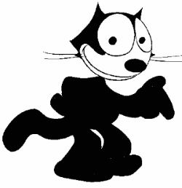
Heritage of Animation
Animation as an art form
First animated character with personality
Felix the cat by Otto Messmer (1920s)
Force to reckoned with
Sound and Walt Disney

Slide 7
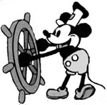
Disney: Animation as an art form
Innovations
Story board to review story
Pencil sketch to review motion
Multi-plane camera stand
Color (not first to use color)
Sound!
Steamboat Willie (1928)

Slide 8
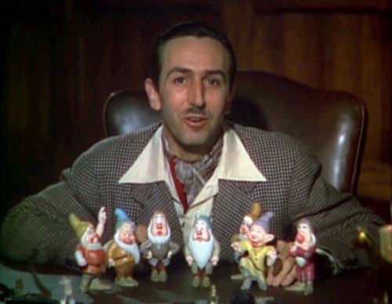
Walt Disney’s Twelve Principles of Animation
During the late 1920’s through the 1930’s, Walt Disney worked to improve the techniques of his studio animators.
Disney set up drawing classes for his animators at the Chouinard Art Institute in Los Angeles under Instructor Don Graham.
Through these lessons and interaction between Disney and his staff, a set of twelve principles was developed.
These principles were used in Disney animated productions including Snow White, Pinocchio, Fantasia, Dumbo, and Bambi.
This work is in the public domain because it was published in the United States between 1923 and 1963 and although there may or may not have been a copyright notice, the copyright was not renewed.

Slide 9
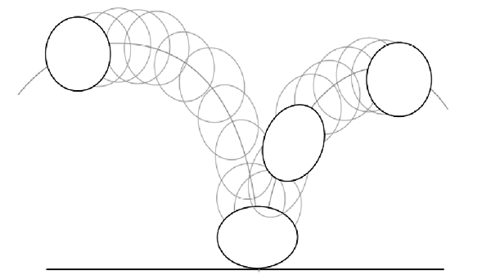
1. Squash and Stretch
Living flesh distorts during motion.
Exaggerated deformations will emphasize motion and impact.
Although objects deform like rubber, they must maintain volume while being squashed and stretched.
A bouncing ball will squash or elongate on impact and stretch vertically as it leaves the point of impact.
This is the most well known and often used principle.

Slide 10
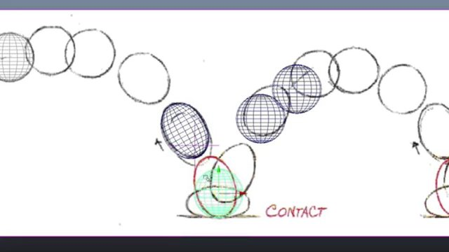
Examples
http://youtu.be/3UazLS_VO00
http://sevencamels.blogspot.com/2011/10/squash-and-stretch-part-one.html

Slide 11
2. Anticipation
Animation can occur before an action. Before you jump, you bend your knees.
By exaggerating this action, the animator can guide the viewer’s eyes.
The formula for most animations is anticipation, action, and reaction.

Slide 12
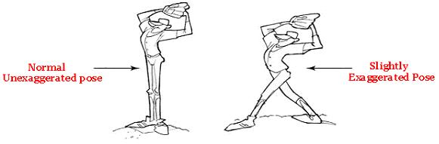
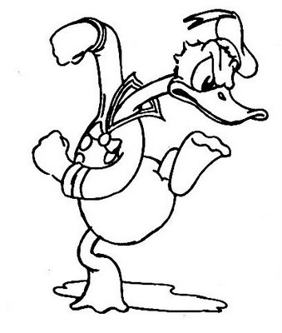
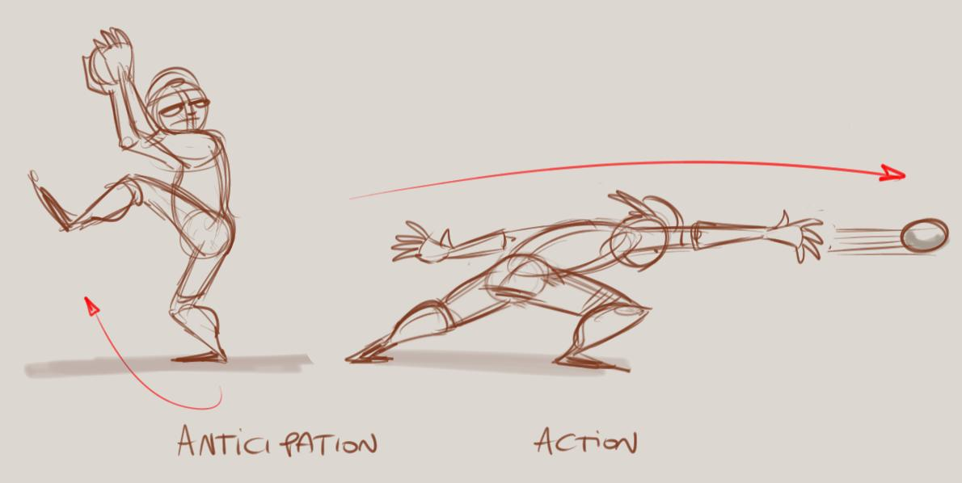

Slide 13
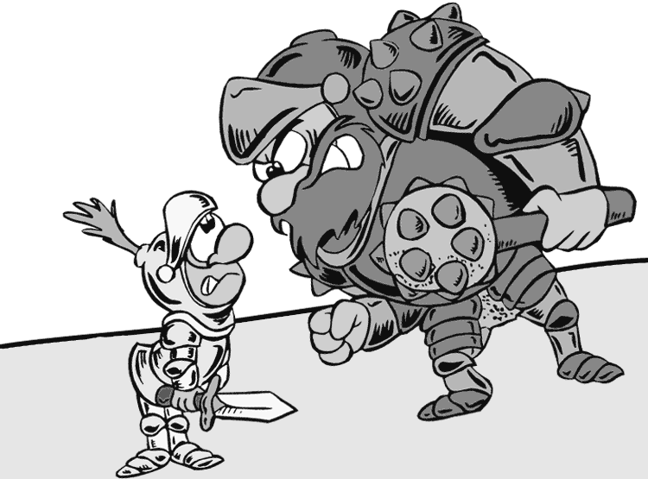
3. Staging
Staging is the clear presentation of an idea.
The animator can use the camera viewpoint, the framing of the shot, and the position of the characters to create a feeling or strengthen understanding.

Slide 14
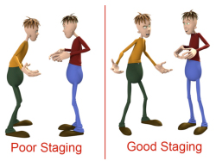
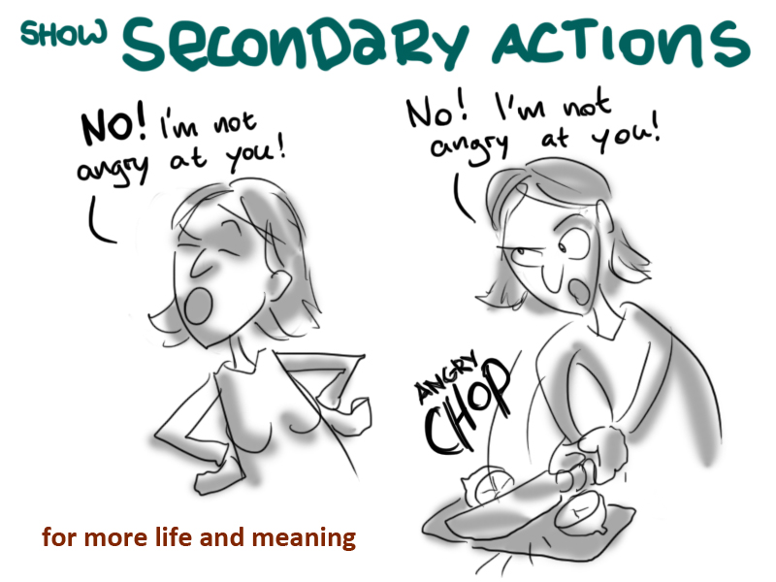

Slide 15
4. Straight Ahead Versus Pose To Pose
Straight Ahead animation means drawing the frames in sequence. This leads to spontaneous motion. It works well with abstract animation.
Pose To Pose is the more often used animation technique. It requires the animator to create strong posed (keyframes) first and add the in-between frames later.
Pose to Pose is used for animation that requires good acting, where the poses and timing are all important.

Slide 16
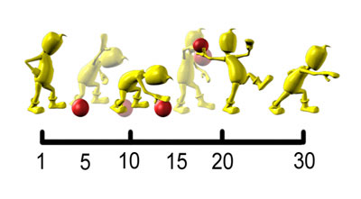

Slide 17
5. Follow Through and Overlap
Follow Through is the action that follows the main action. It is the opposite of anticipation.
When a baseball bat hits the baseball, it does not stop abruptly. A boxer does not freeze at the moment a punch lands.
Overlapping actions means that all elements do not stop at the same time.
Overlapping action also means that a new action may begin before the earlier action is terminated. When hitting a baseball, the legs may begin moving to first base while the bat is finishing the swing.

Slide 18
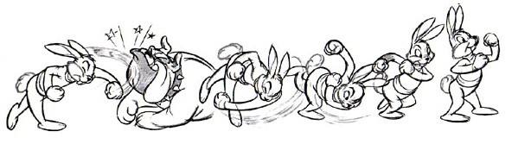
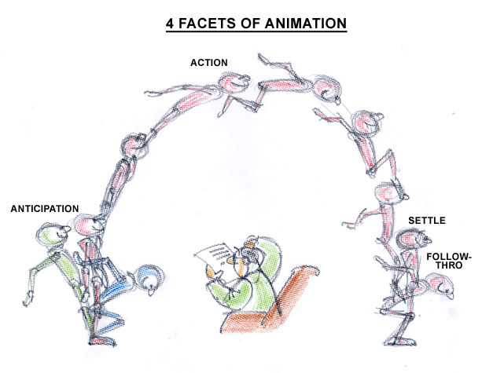

Slide 19
6. Slow In and Slow Out
Also known as ease in and ease out.
Most motion starts slowly, accelerates, and then slows again before stopping. Imagine a car that went 40 mph immediately when stepping on the accelerator and went to 0 mph when hitting the brake.
Gravity has an effect on slow in/slow out. When a ball bounces, it increases in speed as it gets closer to the ground. It decreases in speed at the top of the arch.
In many 3D applications, easing is created by setting the tension of a TCB spline to 1.0. To get the opposition effect from a keyframe, tension is set to -1.0.

Slide 20
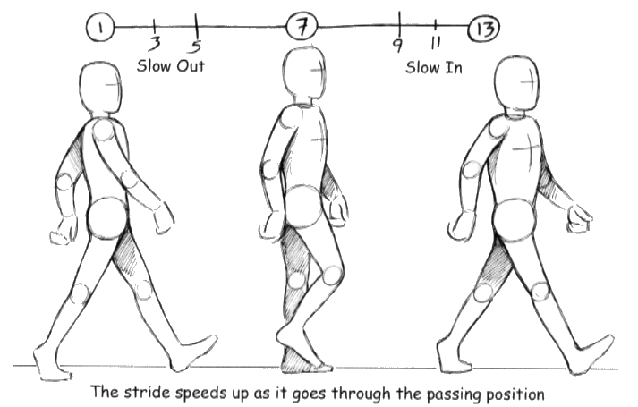
http://www.siggraph.org/education/materials/HyperGraph/animation/character_animation/principles/bouncing_ball_example_of_slow_in_out.htm

Slide 21
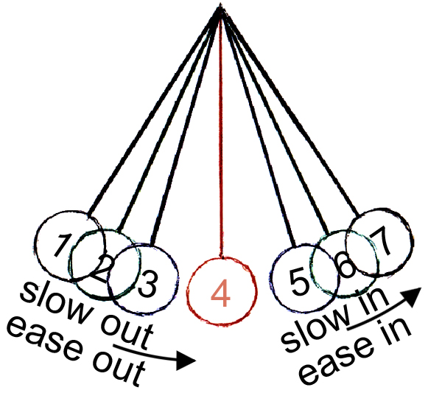
6. Slow In and Slow Out

Slide 22
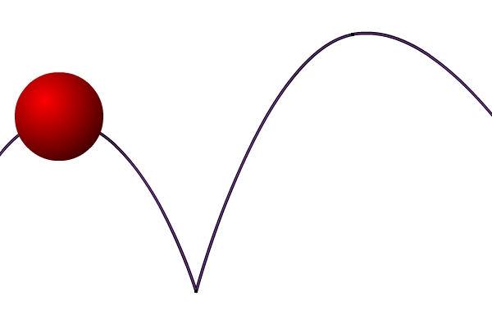
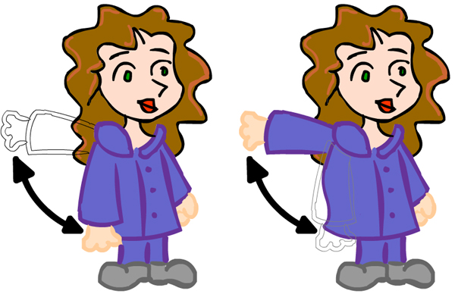
7. Arcs
Almost all natural motion is in some form of an arc.
In 3D animation, a motion arc is usually created using a spline curve.
Pivot points often define the arc. The pivot point for the thigh is the hip, and the pivot point for the calf is the knee.

Slide 23
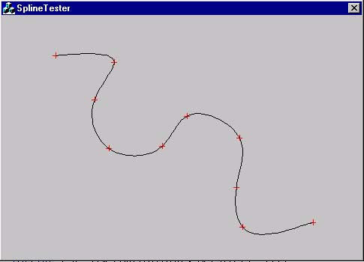
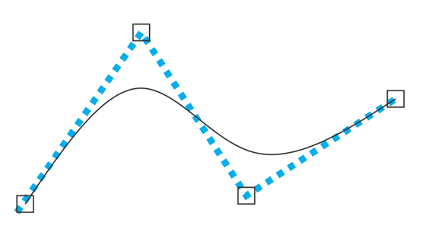
Spline Curves
Piecewise polynomials with smooth connections

Slide 24
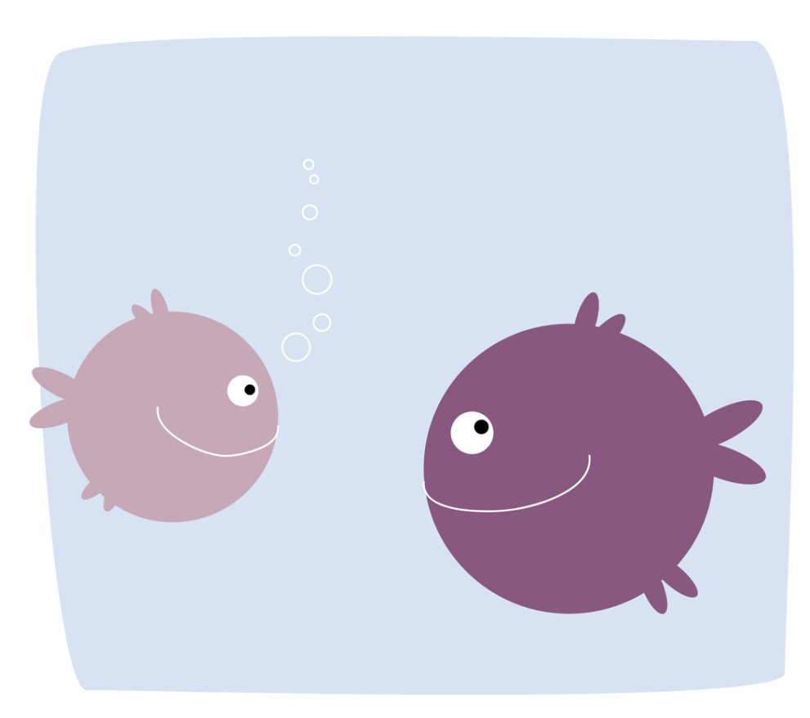
8. Secondary Actions
Secondary actions are minor actions that occur due to a major action. Most people blink their eyes when they turn their head.
Facial expressions are secondary actions.
Secondary actions are also actions caused by the impact of another object. The movement of a ball that has been kicked is a secondary action.

Slide 25
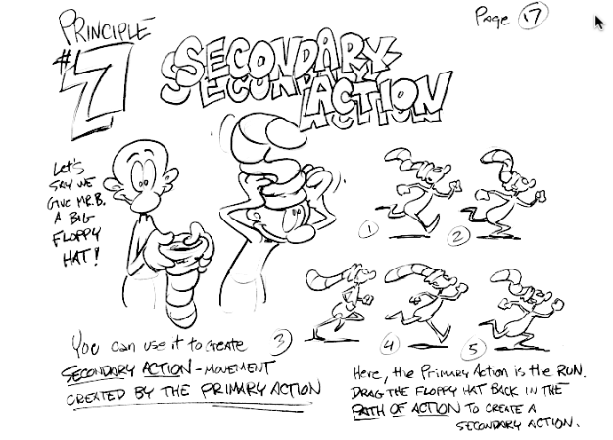

Slide 26
9. Timing
Timing is the amount of frames between poses.
Comedians and actors work with their timing to get the maximum impact from their lines.
Timing can imply weight. Light objects have much less resistance and usually move much quicker than heavy objects.
Speed can imply emotion. A fast walk may mean happiness and a slow walk may mean depression.

Slide 27
10. Exaggeration
Exaggeration is used to increase the readability of emotions and actions.
Animation is not a subtle medium.
Individual exaggerated poses may look silly as stills but add dramatic impact when viewed for a split second.
Animators should be careful to use exaggeration to increase understanding of feeling. Be careful not to over-exaggerate everything.

Slide 28
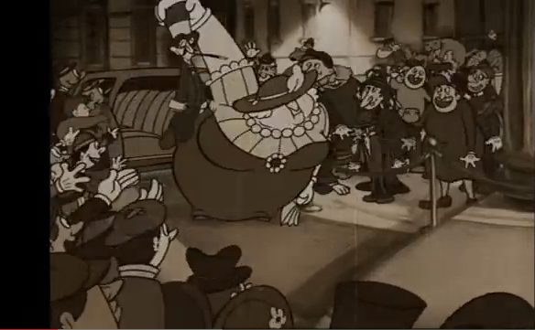
The Triplets of Belleville
https://www.youtube.com/watch?v=X-KChYBFiB0

Slide 29
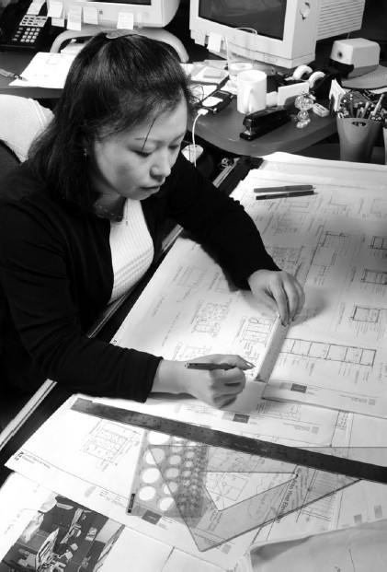
11. Solid Drawing
In 3D animation, this would be equivalent to Solid Modeling.
To get maximum feeling from the audience, animated characters must be drawn or modeled precisely.
Proper drawing and modeling can reveal a character’s weight, character, and emotion.
Proper drawing and modeling are needed to give the character proper depth and balance.
This work is in the public domain in the United States because it is a work prepared by an officer or employee of the United States Government as part of that person’s official duties under the terms of Title 17, Chapter 1, Section 105 of the US Code. See Copyright.

Slide 30
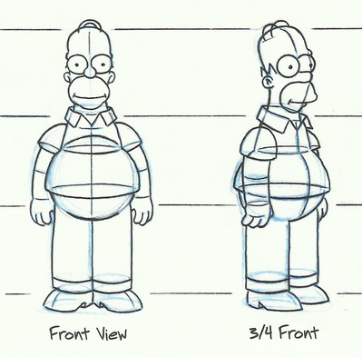
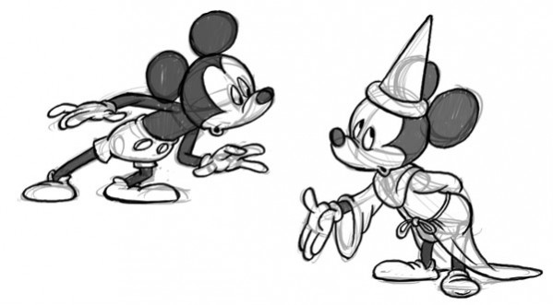

Slide 31

12. Appeal
Animated characters need to have a unique personality and have a wide range of emotions (happy, excited, fearful, embarrassed, angry, scared, etc.).
Character flaws are actually a good thing. Audiences can be sympathetic to characters that have a flaw or two.
Complex personalities and moral ethical dilemmas add to character appeal.

Slide 32
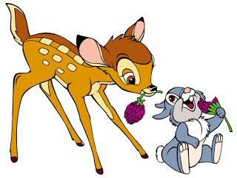
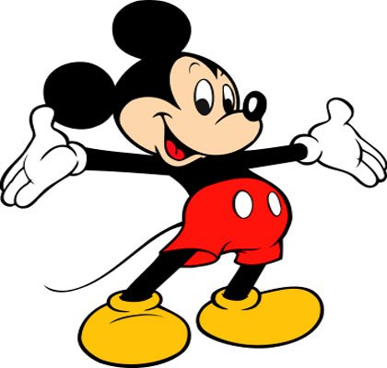
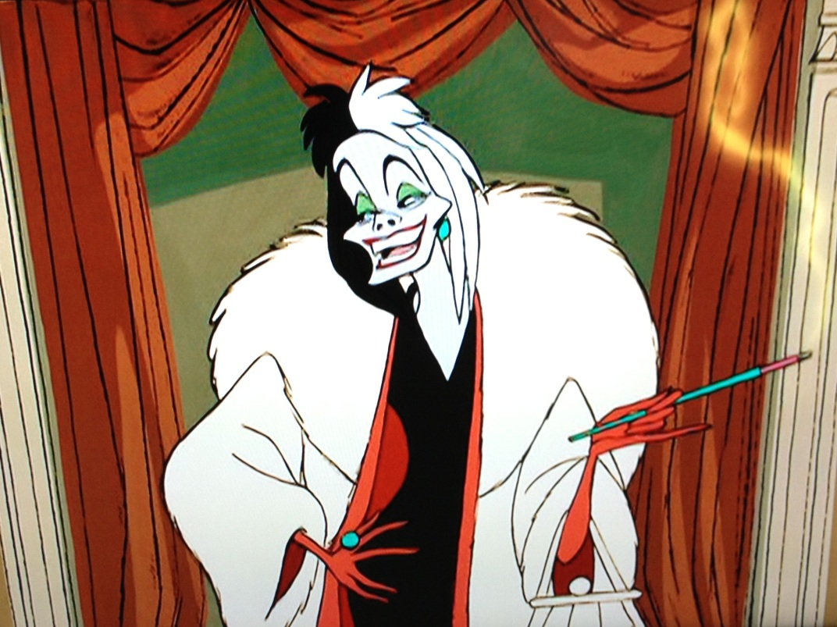

Slide 33
The Classic in the Field
“Principles of Traditional Animation Applied to 3D Computer Animation” (1987)
John Lasseter (fired from Disney in 1984 for promoting computer animation, directed Toy Story in 1995, now chief of Disney Animation)
http://www.siggraph.org/education/materials/HyperGraph/animation/character_animation/principles/prin_trad_anim.htm

